Slide 1


CLARIN Presentation
Notes:
Welcome to this CLARIN café - The CLARIN Café is an informal and interactive space for discussion where researchers, lecturers, students and experts can meet to share experiences and insights that have a potential relevance for the activities and developments within the context of the CLARIN universe.

Slide 2
CLARIN - Common Language Resources and Technology Infrastructure
Has ERIC status since 2012, ESFRI Landmark since 2016
Provides easy and sustainable access:
For scholars in the humanities and social sciences (SSH) and beyond
To digital language data (in written, spoken or multimodal form)
To advanced tools to discover, explore, exploit, annotate, analyse or combine them, wherever located
Through a single sign-on environment
Serves as an ecosystem for knowledge sharing and training
Is one of the European RIs in the SSH open cluster
Actively involved in shaping the European Open Science Cloud (see clarin.eu/eosc)

Slide 3

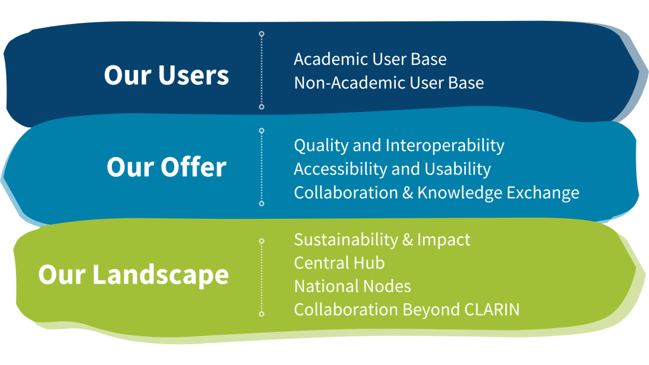
CLARIN Strategy

Slide 4
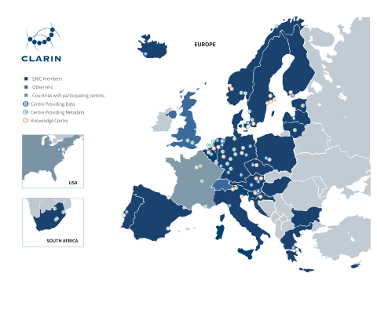
Members and Centres
A distributed network of 70 centres
24 members: AT, BE, BG, CY, CZ, DE, DK, EE, ES, FI, GR, HR, HU, IS, IT, LT, LV, NL, NO, PL, PT, SE, SI, ZA
2 observers: CH, UK
1 third party
CLARIN Value Proposition (link to pdf)
Introducing CLARIN (video)

Slide 5
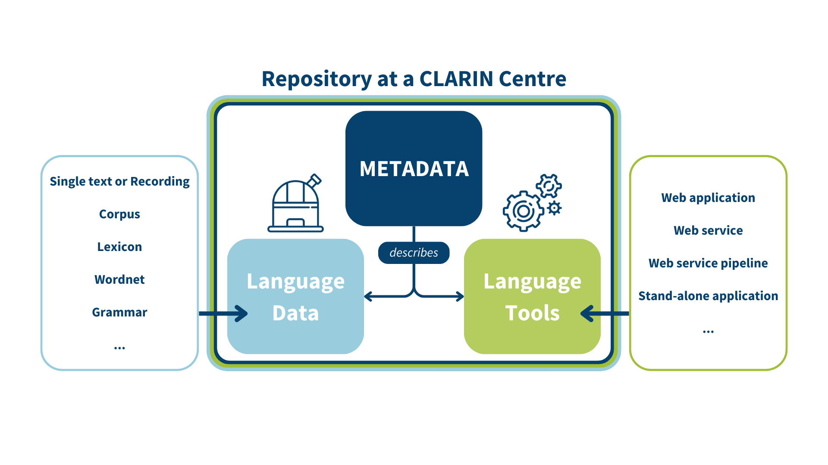
How CLARIN Works

Slide 6


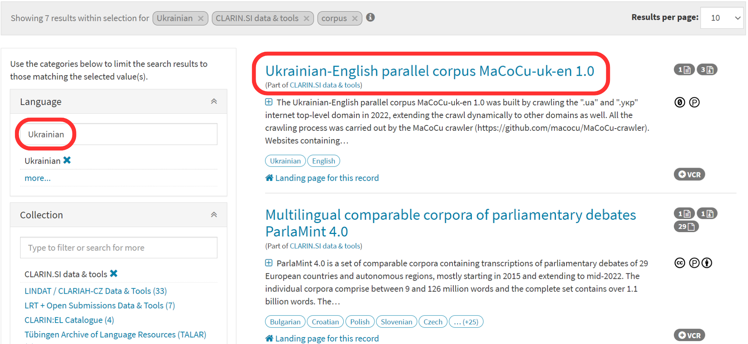


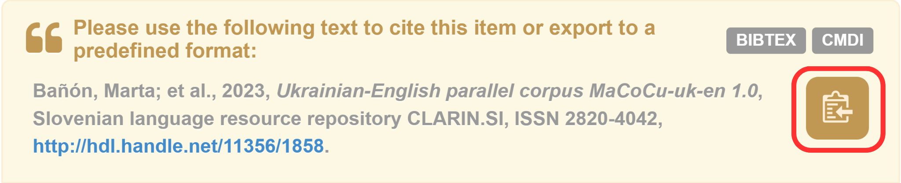
Virtual Language Observatory
https://vlo.clarin.eu
Facet search
Links to landing pages
Download options
Details on licences
Details on technical features
Overview of tools that match the data
Citing LRs:

Slide 7

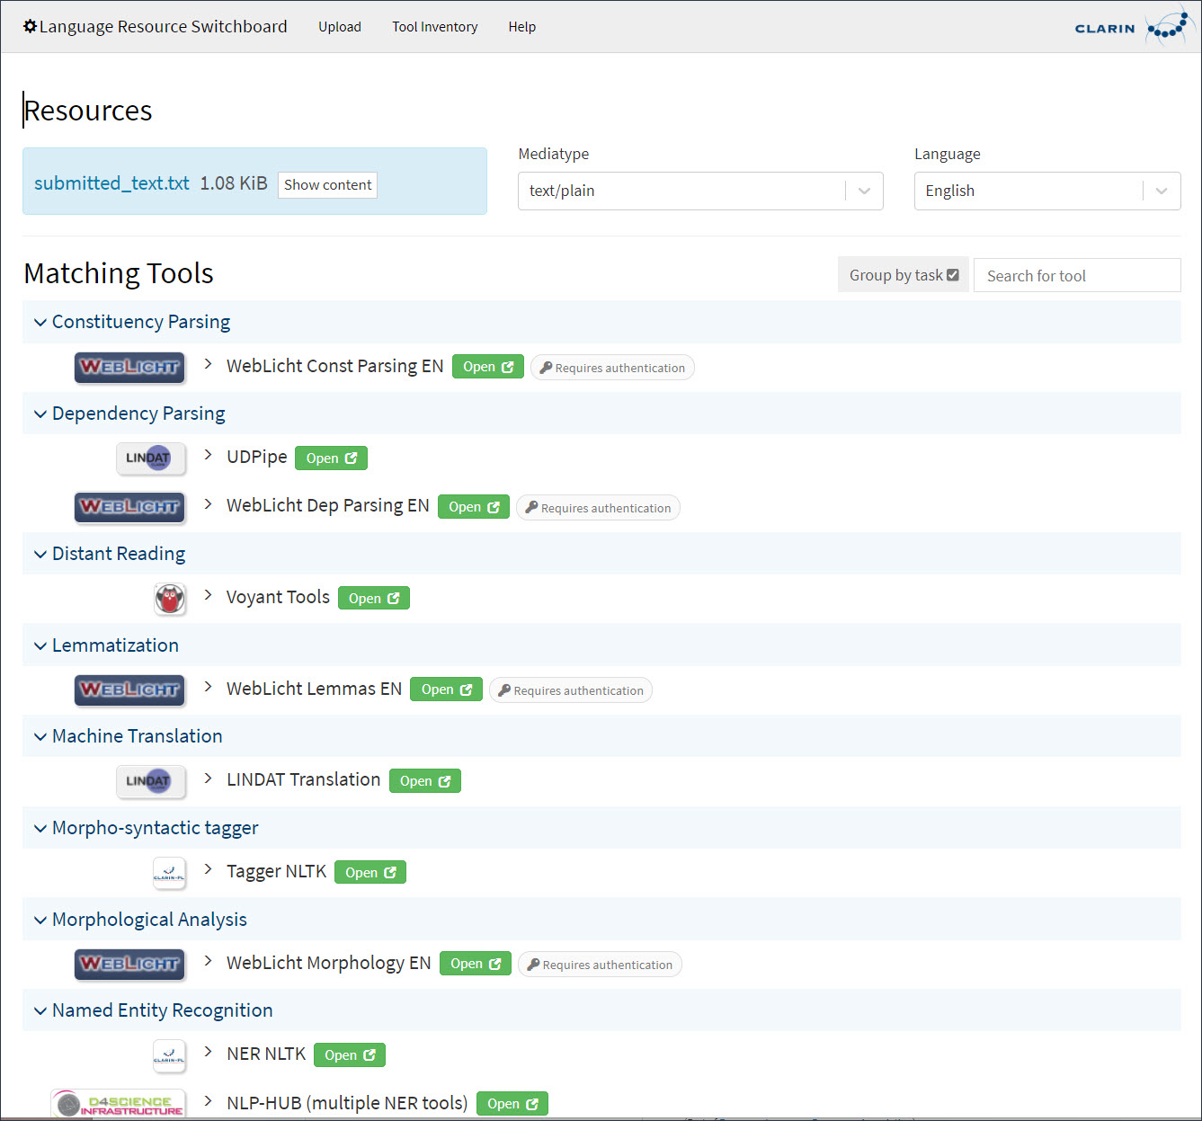
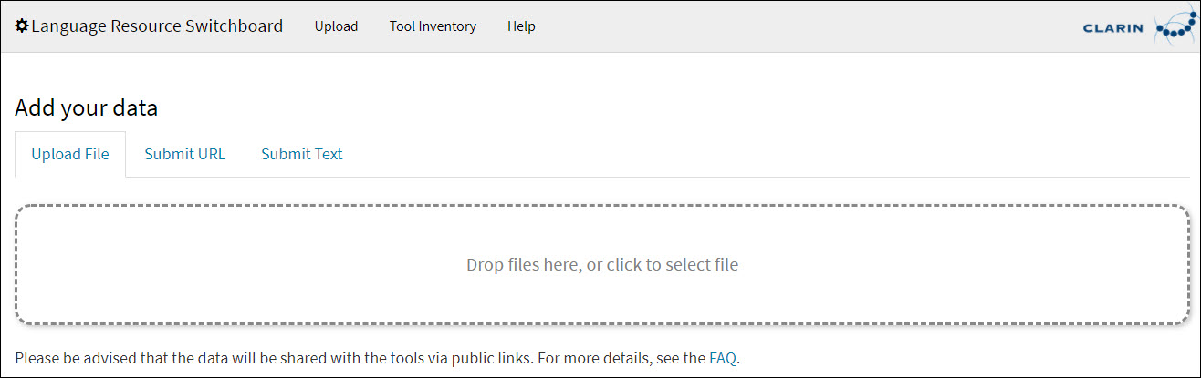
Language Resource Switchboard
https://switchboard.clarin.eu/
Upload a text to find a matching tool for NLP tasks. It can be accessed directly from the VLO.

Slide 8

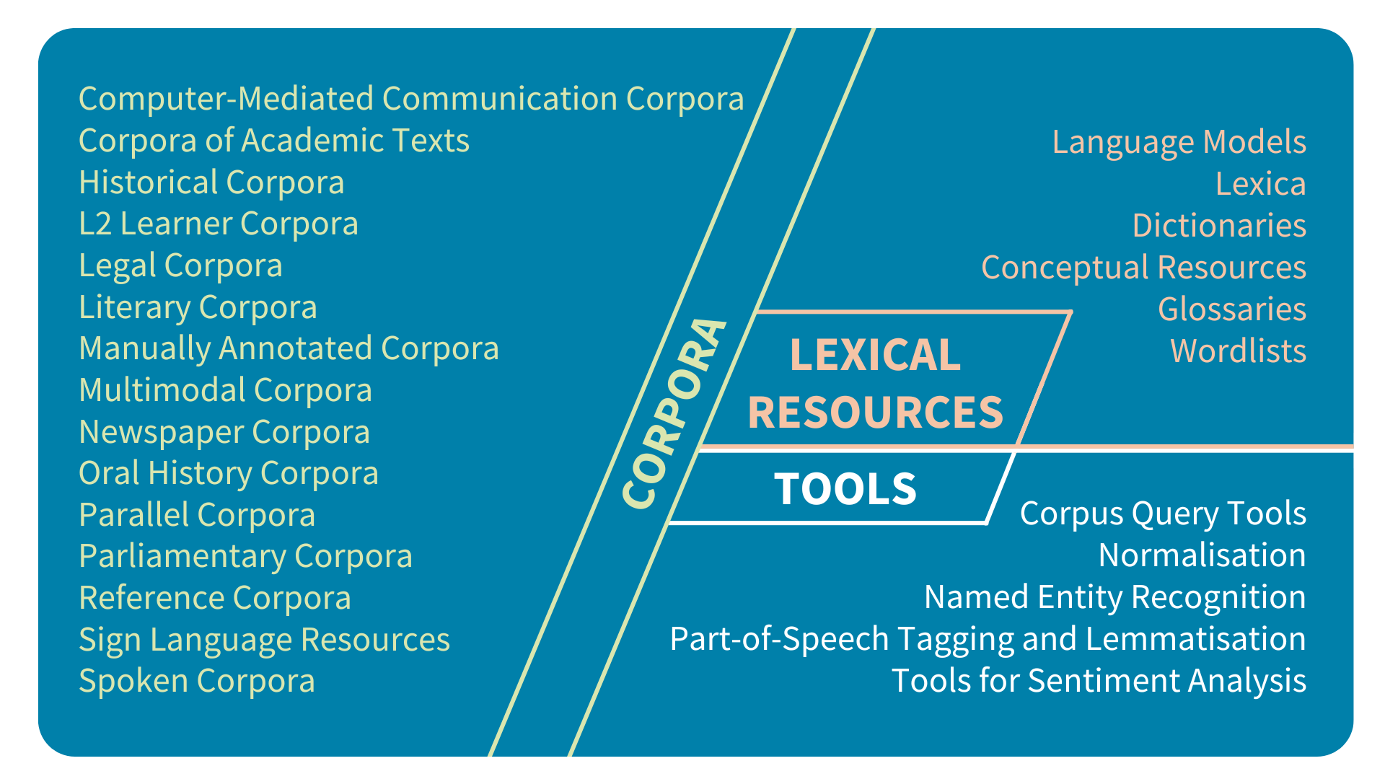
CLARIN Resource Families https://www.clarin.eu/resource-families
A user-friendly overview per data type of the available language resources in the CLARIN infrastructure.

Slide 9
Finding & Sharing Knowledge & Expertise in CLARIN
CLARIN committees:
Knowledge Infrastructure - K-centres, best practice papers, ...
Legal and Ethical Issues
Standards and Interoperability & CLARIN Standards Information System
User Involvement
CLARIN Trainers’ Network
CLARIN Ambassadors
Mobility Grants

Slide 10
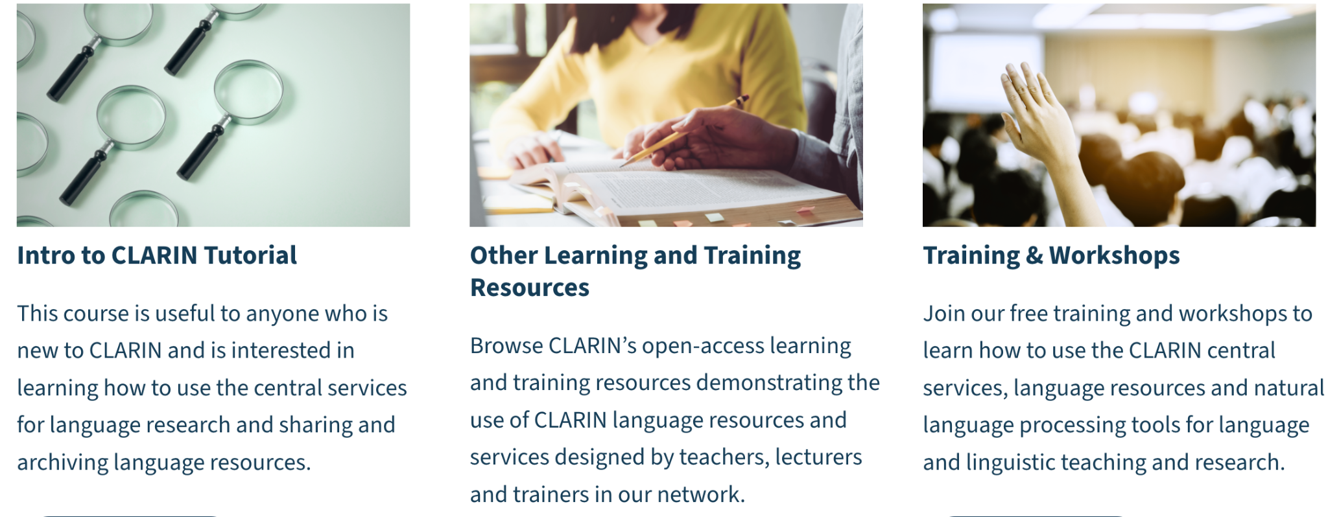

CLARIN Learning Hub
Learning Hub | CLARIN ERIC
Join the trainers’ mailing list

Slide 11
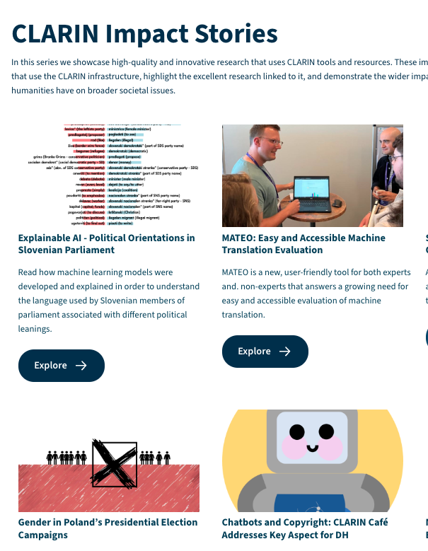

Impressions: Impact Stories and Tour de CLARIN
CLARIN Impact Stories
Tour de CLARIN

